Slide 1
How to use these slides These slides can be used by anyone who would like to deliver a basic awareness session on advance care planning. If you need more information or have any questions contact Compassion in Dying: 0800 999 2434 / info@compassionindying.org.uk

Slide 2
Introduction to Advance Care Planning
Notes:
Hello my name is…
Today I am going to:
explain what advance care planning is
give you some information on three tools you can use to make your own plan
tell you about the free information and help that’s available.

Slide 3
What is Advance Care Planning?
Advance care planning helps health and care professionals, and those close to you, to understand how you want to be cared for if you become too unwell to make decisions or speak for yourself
For example, at the end of life with advanced dementia or after a severe brain injury.
You can record your wishes in an advance care plan.
Notes:
Recording your wishes allows you to express who you are and what is important to you.
This gives you control over your treatment and care, and reassurance that the right decisions will be made.
It can also be a good way to start conversations with your friends and family about what you want in the future.

Slide 4
Why do people plan ahead?
“I don’t want an injection that would stop me from saying my prayers”
“I want to make sure they know I am a vegetarian”
“I am worried about being alone in hospital and not able to tell the Doctors what is important to me”
“I want to make things easier for my family ”
“I want to make things easier for my family ”
“I want my daughter to make decisions about my treatment”
“I want to be cared for at home not in hospital”
Notes:
Here are some reasons why people plan ahead.
As well as having huge benefits for you, when people plan ahead it makes the healthcare professional’s job easier as they can feel confident knowing they are following the person’s wishes.
It saves time, decisions can be made quicker in time pressured situations, and people will not be given treatments they do not want.
It helps with disputes surrounding care or treatment options, this could be between healthcare professionals or between the family or friends of the individual.
Ultimately it’s an empowering and positive thing to do!

Slide 5
Capacity and decision-making
If you lose capacity your next of kin do not have the authority to make treatment decisions - unless you have appointed them as your Lasting Power of Attorney for Health and Welfare.
If you haven’t made an advance care plan and a decision needs to be made about treatment, the final decision will be made by a healthcare professional. This might not be what you would have wanted.
Best interests decision
Notes:
What we are talking about today is underpinned by the mental capacity act.
Capacity is the ability to make a decision for yourself.
You need to have capacity to make an advance care plan.
If you have capacity then you can give or refuse consent to treatment.
If you don’t have capacity your next of kin do not have the authority to make treatment decisions - unless you have appointed them as your Lasting Power of Attorney for Health and Welfare.
If you haven’t made an advance care plan and a decision needs to be made about treatment, the final decision will be made by a healthcare professional. This might not be what you would have wanted.
… so now I am going to talk about three advance care planning tools

Slide 6
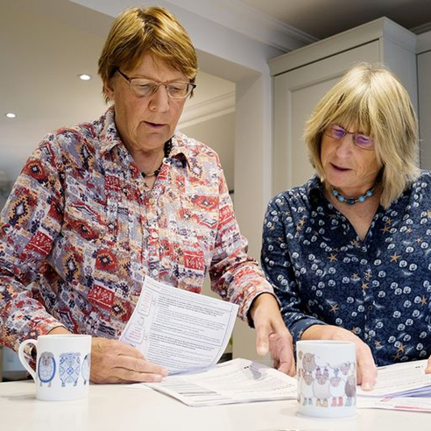
Advance Statement
A general statement of anything that is important to you in relation to your health or wellbeing. It can contain information about your lifestyle, the care you would prefer to receive, and what is important to your quality of life. It is used if you are unable to tell people how you want to be cared for.
Notes:
The first tool is an advance statement. It is a general statement of anything that is important to you in relation to your health or wellbeing. With many of us living a long time without capacity to make important decisions, this helps people know who you are and what matters to you.
It is free.
It is not legally binding but has legal weight which means it does need to be taken into consideration when a decision needs to be made about someone’s care and treatment.
It can Include anything that is important to you and your quality of life.
Its important that people understand that not all their requests (for example staying at home) can be respected but having an advance statement helps open up important conversations about the practicalities of future care.
It helps people understand what’s achievable and ensures everyone is on the same page – this results in better eol experiences.

Slide 7
Advance Decision to Refuse Treatment
Allows you to record any medical treatments that you do not want to be given in the future, in case you later cannot make or communicate a decision for yourself.
It is legally binding as long as it meets certain requirements. It is free.
Notes:
The second tool is an Advance Decision to Refuse Treatment. An Advance Decision to Refuse Treatment is a legally binding document which means it must be followed by doctors.
It is free to make and you do not need a solicitor.
An Advance Decision is sometimes called a Living Will or an Advance Directive.
You must say what treatments you want to refuse and in what circumstances. For example, if you did not have capacity and you would not regain capacity you might want to refuse life-sustaining treatments to keep you alive.
Your Advance Decision will only be used if you lack capacity to make a decision.

Slide 8
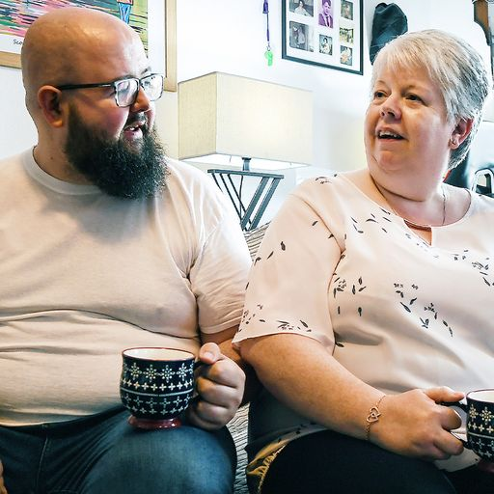
Lasting Power of Attorney for Health and Welfare
Allows you to give someone you trust the legal power to make decisions for you if you are unable to.
It covers decisions about medical treatment, where you are cared for, and your daily routine.
It’s legally binding and you don’t need a solicitor.
It costs £82 but is free for those on certain benefits.
Notes:
The third tool is a Lasting Power of Attorney for Health and Welfare (LPA).
An LPA gives the person or people you trust the legal power to make decisions on your behalf, If you are unable to.
It covers decisions about medical treatment, where you are cared for, and your daily routine.
It’s legally binding and you don’t need a solicitor.
It costs £82 but is free for those on certain benefits.
You must have someone you trust who is willing and able to fight your corner and not everyone has this – it is not an easy job.
You cannot nominate yourself as someone else’s Power of Attorney – many people we have met in Newham think they can.
Next of kin do not have any legal authority to make health and care decisions.
You must have capacity to make an LPA.

Slide 9
Advance Care Plans must be shared
Universal Care Plan
Family & friends
Other people involved in their care
Sharing your plan
Medic Alert
Summary care record
Notice of ADRT card
Notes:
Its really important that your advance care plan is shared, with the people involved in your care.
People should speak to their GP about recording it on their medical records.
The more people that know about it and have a copy the better.
If you have made an Advance Decision to Refuse Treatment (ADRT) with Compassion in Dying then you can carry their ADRT card.
You can also buy a Medic Alert Bracelet stating you have an ADRT and ask your local ambulance service to keep a copy.
Review regularly, and update where necessary especially if you have a new diagnosis or your wishes have changed.

Slide 10
Key points
 | Key points
Advance Statement | Telling people what is important to you Free Not legally binding but must be used to help make decisions about your care
Advance Decision to Refuse Treatment | For refusing treatment Free Legally binding
Lasting Power of Attorney for Health and Welfare | Giving another person authority to make decisions about treatment and care Legally binding £82 or free for with certain benefits
Notes:
All these documents work well together.
You can choose any or all of them.
You can complete them all yourself and you don’t need a solicitor for any of them.
They only come into effect if people lose capacity to make decisions for themselves, and you can change your mind at any time while you have capacity.

Slide 11
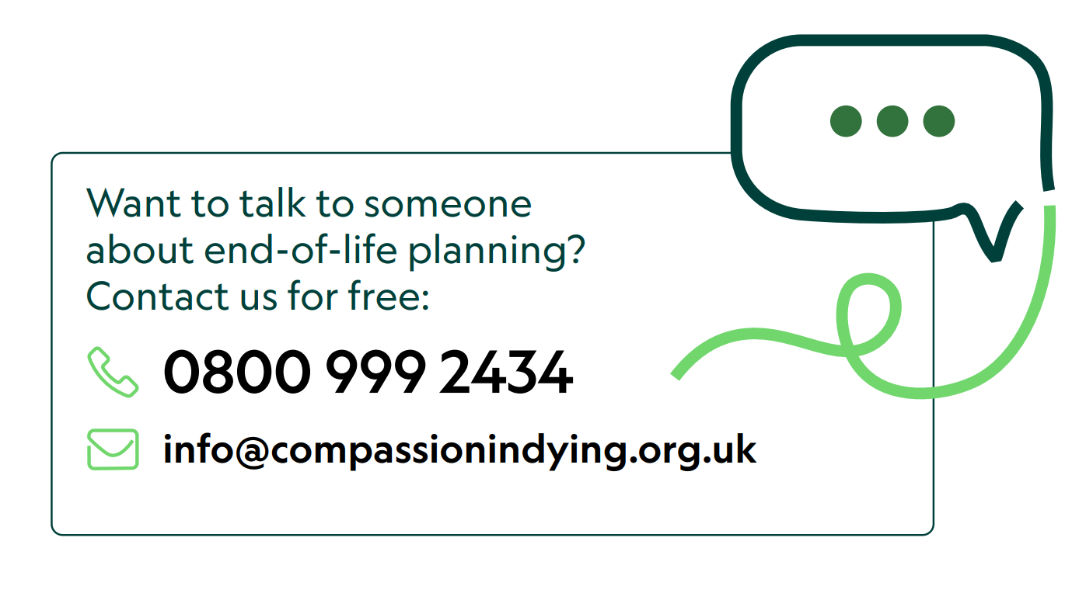
Support
Notes:
If you would like more information contact Compassion in Dying
You can also have a look at newham-planning-ahead-leaflet

